Slide 1
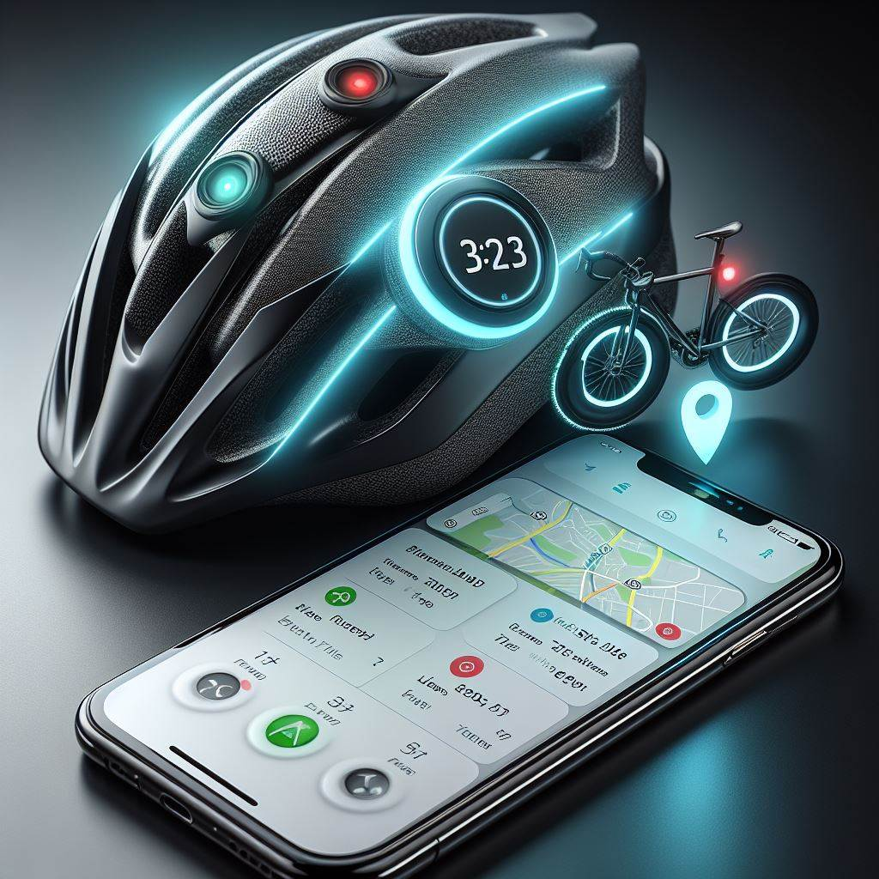
SmartRide

Slide 2
Introduction
At SmartRide, we are on a mission to transform the way people commute and travel.
Our innovative technology and cutting-edge solutions are set to revolutionize the future of transportation.
With a focus on sustainability, efficiency, and convenience, SmartRide is poised to disrupt the traditional transportation industry.

Slide 3
Problem
The current transportation landscape is plagued with numerous challenges.
Traffic congestion, pollution, and limited mobility options are just a few of the issues faced by commuters worldwide.
Additionally, the lack of integration and connectivity between different modes of transportation creates a fragmented experience for users.

Slide 4
Solution
SmartRide offers a comprehensive and seamless transportation ecosystem that integrates various modes of transportation into a single platform.
Our smart mobility solution combines ride-sharing, public transportation, micro-mobility options, and more, providing users with a convenient and efficient way to navigate their cities.

Slide 5
Product Features
SmartRide App: Our user-friendly mobile application allows users to plan, book, and pay for their entire journey, including multiple modes of transportation.
Integration with Existing Systems: SmartRide seamlessly integrates with existing transportation infrastructure, including public transit systems and ride-sharing services, to provide a unified experience.
Real-time Data and Insights: Our advanced analytics and data-driven approach enable us to optimize routes, reduce congestion, and improve overall transportation efficiency.

Slide 6
Market
The market potential for SmartRide is immense.
With the global urban population on the rise and increasing demand for sustainable transportation solutions, our target market includes commuters, city dwellers, and businesses looking to enhance their employees' commuting experience.

Slide 7
Competitive Advantage
Seamless Integration: Unlike our competitors, SmartRide offers a truly integrated solution that combines various transportation modes, eliminating the need for multiple apps or platforms.
Sustainability Focus: We prioritize sustainability by promoting the use of eco-friendly transportation options, reducing carbon emissions, and contributing to a greener future.
Advanced Technology: Our proprietary algorithms and machine learning capabilities enable us to optimize routes, predict demand, and provide personalized recommendations to users.

Slide 8
Traction
SmartRide has already gained significant traction in pilot cities, with thousands of users benefiting from our platform.
We have formed strategic partnerships with local transportation authorities and have received positive feedback from both users and industry experts.

Slide 9
Team
Our team consists of industry experts, technologists, and transportation enthusiasts who are passionate about revolutionizing the way people travel.
With a diverse skill set and a shared vision, we are well-equipped to drive SmartRide's success.

Slide 10
Fundraise
We are seeking investment to scale our operations, expand into new markets, and further enhance our technology.
Join us in revolutionizing the future of transportation and be a part of the SmartRide journey.

